Slide 1
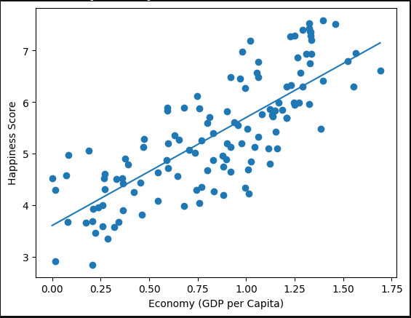
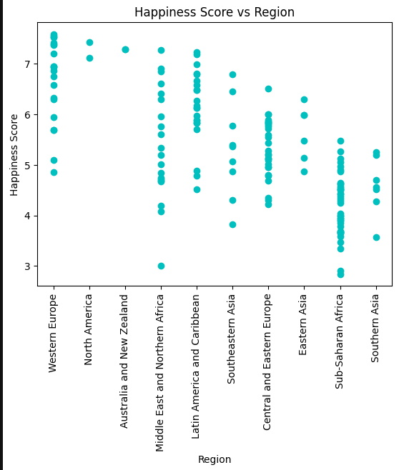
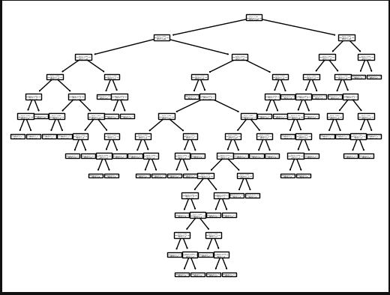
Analyzing the World Happiness Index using Machine Learning Techniques
Gunnar Grispino
S534171@nwmissouri.edu
Goals
Exploration of the Data
Findings
My goal was to take the World Happiness Report – a ranking of the happiness of the world's countries, along with metrics such as their GDP, life expectancies, etc and apply machine learning concepts to accurately predict other features or perform classifications.
There were a things I found that spoke to me.
The decision tree model I implemented was highly inconsistent. This shows why something like a random forest classifier can be so valuable.
Adding more features didn't necessarily improve our models' performance. Things like overfitting and convolution came into play.
Models used:
KMeans, Random Forest, Elasticnet, DecisionTreeRegressor, SVM
Example of one of our Linear Regression Models
The Data
Source – 2015 World Happiness Report via the Sustainable Development Solutions Network
Description of Features – Various metrics about the quality of life in these countries, such as GDP, life expectancies, government trust.
Cleaning – The data was already in usable csv form. All I had to do was add a numerical category for region.
Decision tree to classify a country's region
Future Directions
Repository Link
Improve and refine our models (play around with certain coefficients, etc.)
Experiment with different models, especially linear.
Experiment with different combinations of features for classification.
https://github.com/44-566-Machine-Learning-S24/ml-s24-project-grispinogunnar

